Slide 1
CASE-BASED SCENARIOS BY IDENTIFYING ENTITIES AND
RELATIONSHIPS.
CSA0504
Name:L.Meghana
Reg no:192524107

Slide 2
1.CREATE AND PRESENT AN ER DIAGRAM FOR AN ONLINE LIBRARY
SYSTEM, EXPLAINING EACH COMPONENT CLEARLY.
Online Library System – ER Diagram
Manages books and members
Tracks borrowing and returning
Stores library records
Uses ER model for database design

Slide 3
ER DIAGRAM COMPONENTS
Entities: Real-world object (Book, Member)
Member
Book
Librarian
Loan
Attributes: Describes an entity
Member ID, Name
Book ID, Title
Loan Date, Return Date
Relationships: Connects entities
Member borrows Book
Librarian manages Loan
Primary Key: Unique identifier (Book ID, Member ID)

Slide 4
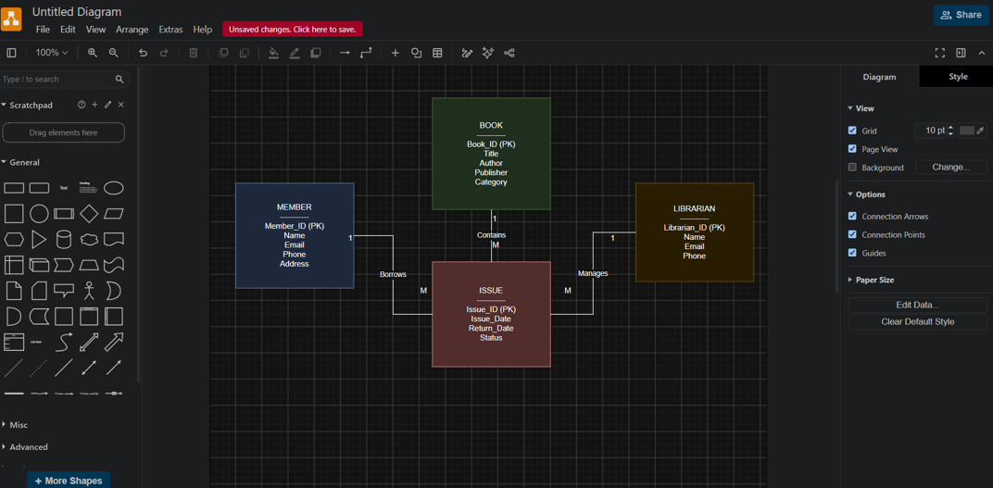
ER DIAGRAM

Slide 5
2.PREPARE A PRESENTATION ON THE EER MODEL, DEMONSTRATING GENERALIZATION AND SPECIALIZATION WITH A UNIVERSITY CASE
Enhanced ER (EER) Model
Extension of ER model
Supports inheritance
Represents complex data
Uses specialization and generalization

Slide 6
UNIVERSITY CASE STUDY
Superclass
Person
Specialized Subclasses
Student
Faculty
Staff
Each subclass inherits:
Person ID
Name
Address
Additional attributes:
Student → Semester
Faculty → Department
Staff → Designation

Slide 7
GENERALIZATION AND SPECIALIZATION
SPECIALIZATION
Divides one entity into multiple subgroups.
Example: Person → Student, Faculty, Staff.
GENERALIZATION
Combines similar entities into one superclass.
Reduces duplication of common attributes.
Makes the database easier to maintain.
Improves data organization.

Slide 8
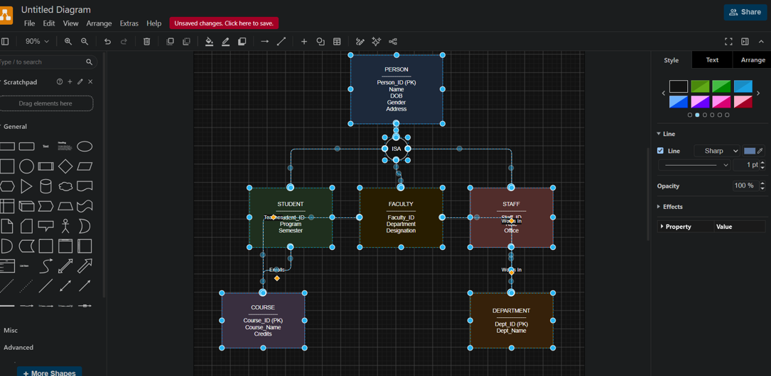
EER DIAGRAM

Slide 9
3.PRESENT THE CONCEPT OF DATA INDEPENDENCE (LOGICAL AND
PHYSICAL) AND ITS SIGNIFICANCE IN DBMS ARCHITECTURE.
Introduction
Data independence means modifying one level of the database without affecting another.
It is a key feature of DBMS architecture.
It separates application programs from database changes.
Supports easy database maintenance.
Based on the three-schema architecture.
Improves flexibility and scalability.

Slide 10
TYPES OF DATA INDEPENDENCE
Physical Data Independence
Changes physical storage methods.
Logical schema remains unchanged.
Example: Changing file organization.
Logical Data Independence
Changes logical database structure.
User applications continue working.
Example: Adding a new attribute.

Slide 11
IMPORTANCE OF DATA INDEPENDENCE
Simplifies database maintenance.
Reduces application modifications.
Supports future database expansion.
Improves system performance.
Protects user applications from internal changes.
Makes database management more efficient.

Slide 12
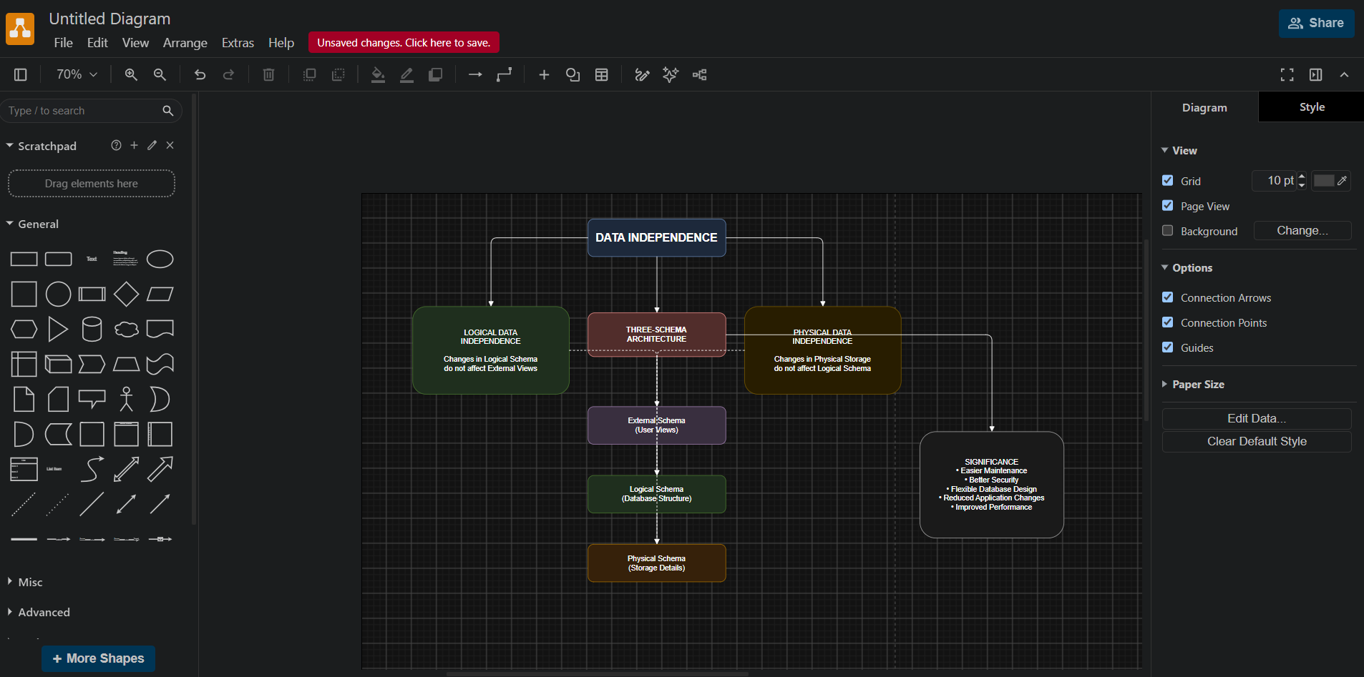

Slide 13
4.DELIVER A TECHNICAL PRESENTATION ON THE SOFTWARE COMPONENTS
OF A DBMS, EXPLAINING QUERY PROCESSOR, STORAGE MANAGER,
AND TRANSACTION MANAGER.
DBMS consists of different software modules.
These modules process, store, and manage data.
The three major components are:
Query Processor
Storage Manager
Transaction Manager
Each component performs a specific function.
Together they ensure efficient database operations.

Slide 14
Query Processor
Accepts SQL queries.
Checks syntax and validity.
Optimizes query execution.
Retrieves requested data efficiently.
Storage Manager
Manages files and indexes.
Controls data storage on disks.
Allocates memory space.
Retrieves stored data quickly.

Slide 15
Transaction Manager
Manages multiple database transactions.
Ensures ACID properties.
Maintains data consistency.
Supports concurrent user access.
Handles Commit and Rollback operations.
Prevents data loss during failures.

Slide 16
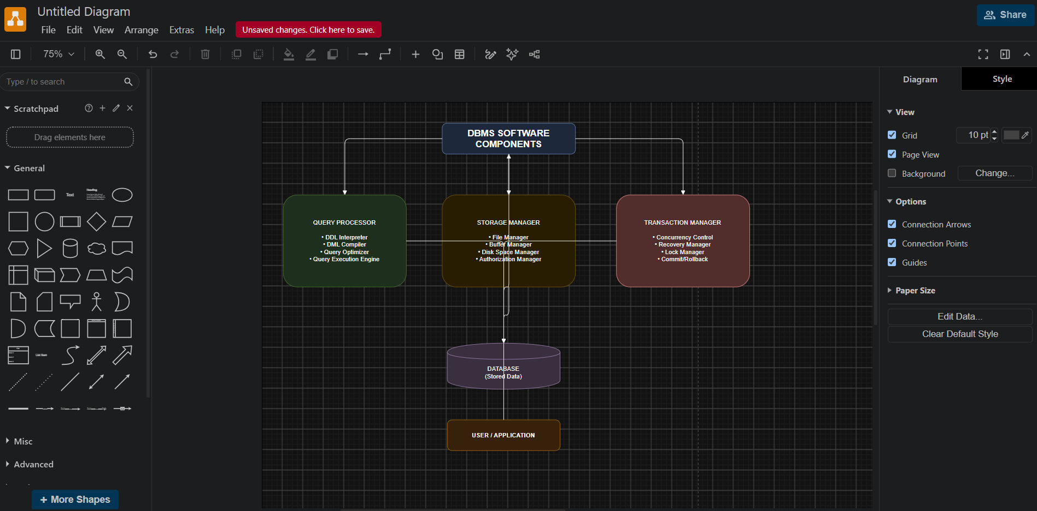

Slide 17
5.PREPARE A PRESENTATION COMPARING STRONG AND WEAK ENTITIES IN ER MODELING WITH REAL-WORLD EXAMPLES.
Introduction
Entities represent real-world objects in a database.
They are classified as Strong or Weak entities.
Strong entities exist independently.
Weak entities depend on another entity.
Both are represented differently in ER diagrams.
They help define database relationships.

Slide 18
Strong Entity
Characteristics
Has its own primary key.
Exists independently.
Represented by a single rectangle.
Does not depend on another entity.
Examples
Student
Employee
Book
Customer

Slide 19
Weak Entity
Characteristics
Has no complete primary key.
Depends on a strong entity.
Uses a partial key.
Represented by a double rectangle.
Connected using an identifying relationship.
Examples
Employee → Dependent
Order → Order Item
Library Member → Loan Record

Slide 20
